Slide 1

Walmart Retail Sales and Profit Analysis Jaskeerat Singh s4761003
Notes:
The data consists of monthly/yearly sales and profit of different Walmart stores in the USA.

Slide 2
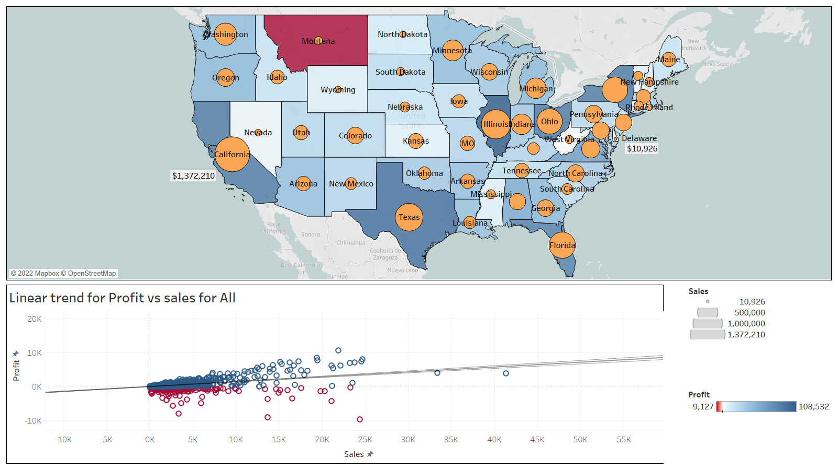
Notes:
The Map shows the Sales and Profit of each state for the year 2020.
From the map we can see that Montana has the least profit while California, Texas and Illinois has the largest profit.
California has the largest sales among all the states while Delaware has the lowest sales at approx. $11,000.
The overall trend between Profit and Sales is increasing, even though we can see negative profits for positive sale points.

Slide 3
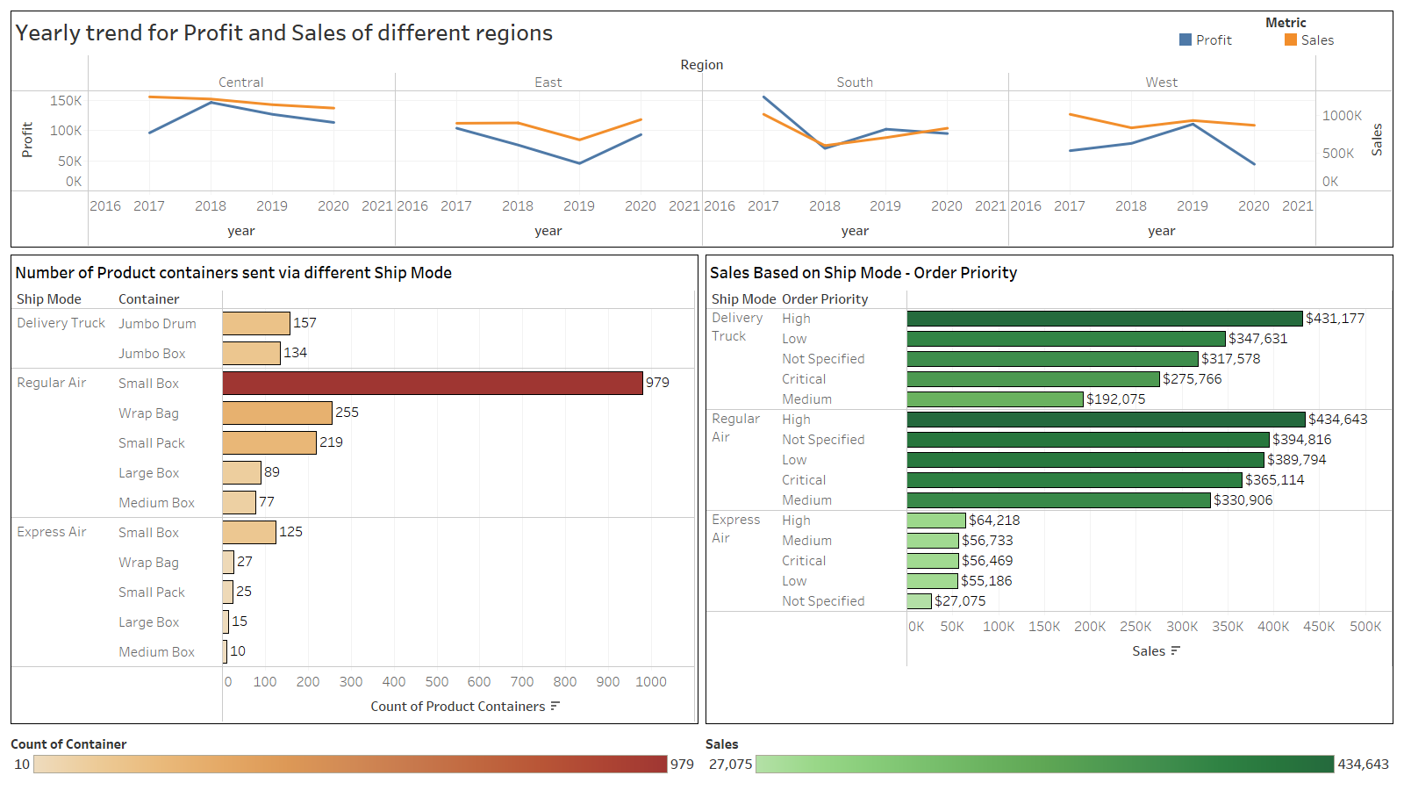
Notes:
Here we can see the trend of Sales and profit in different regions. From this we can infer that in the west we have the sharpest decrease in profit, while in the south the sales pattern did not suffer from any deviation and kept on increasing. East was the only region which bucked the trend and saw positive Sales and profit when compared to 2019.
When it comes to Shipping mode, Regular Air is the most preferred Shipping mode to send the containers of any type. Delivery Trucks were mostly used to ship Jumbo Containers.
Sales based on order priority were similar for Delivery Truck and Regular air. Low sales were recorded for even High priority orders in Express air.

Slide 4
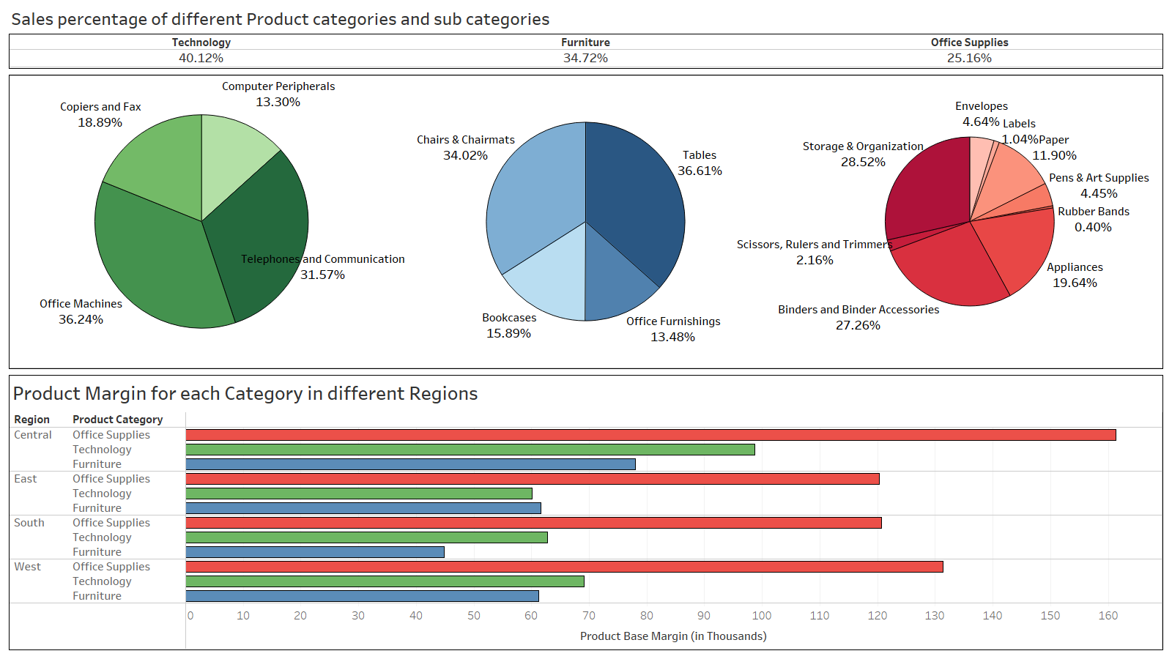
Notes:
Here, we can see that majority of the sales is coming from Technology and Furniture categories.
Technology devices like office machines, telephones and communication gadgets make bulk of the sales nearly 68% of the category.
From furniture we can see that tables and chairs make bulk of the sales amounting to more than 70% of the whole category.
Office supplies make 25% of the sales percentage where containers like storage and binder material make more than 50% of the total sales.
At the end we can see that even though office supplies make the lowest percentage of the total sales, it accounts for the highest product margin in every region of USA.

